Slide 1


Slide 2



About Us
An African inspired Advisory and Educational Marketing Services Company
Boo-Yah! aims to put the ”KAPOW”
back into your marketing and help brands build
”Blockbusting”Strategies
FUTURE-FIT for Industry 4.0

Slide 3


Losing our Way?
NEW
PACE
TACTICS
Notes:
I have talked to hundreds of marketers over the years in SA and there are 3 common denominators I identify. Too Many marketers lost their way chasing the new-overwhelmed by the pace, focussed on tactics not on strategy. We need to go back to the basics. NOT YOUR FAULT- conditions around you that make it hard to manage transformation.

Slide 4
Notes:
According to Martech Landscape of Marketing Tech has rised significantly. Trends will rise in Tech Space. But It is impossible to apply all the trends. We need to choose what is right for our customers and their needs.

Slide 5

Future Shock:
too much change in too short a period of time
Alvin Toffler
Notes:
If you think Today is fast, It is the slowest its ever going to be

Slide 6
70 – 20 – 10 Innovation Model
What we should be doing?
70 % Day to Day
20 % Improving
10 % Exploring
What’s really happening?
90 % Day to Day
10 % Crisis Management

Slide 7
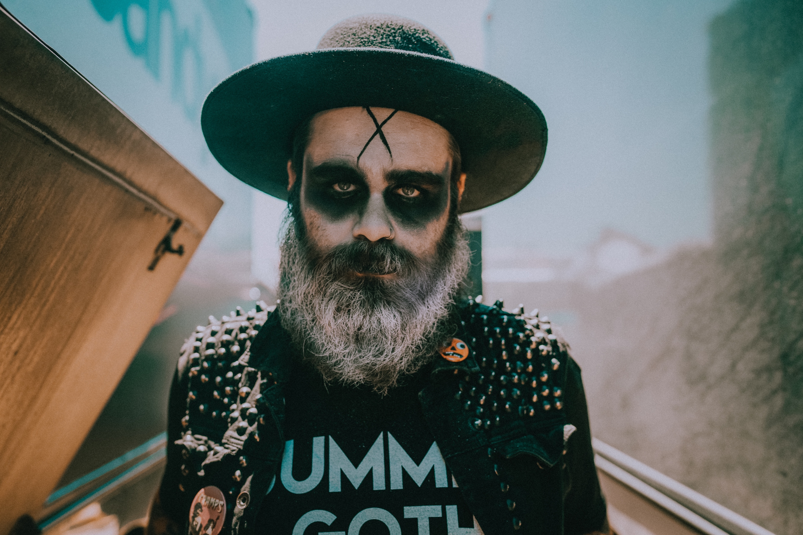

We are becoming the
”Walking Dead” Professionals of our time
Notes:
Attention is finite recourse. We are so busy being busy. We are becoming the walking dead professionals of our time….

Slide 8

“We are so busy getting the job done, being in meetings, and making targets that we neglect the important things that stand between surviving and thriving”

Slide 9

Where we can we help you Thrive?
INNOVATION MODEL
Exploring
Improving
Day-to-Day
Notes:
Future-fit

Slide 10

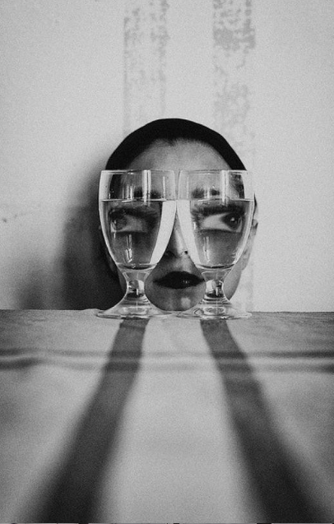

EXPLORING: Fuel Creativity Inspire Innovation
Boo-Yah!
Building Culture of Purpose

Slide 11


Recent research shows that employees at Companies with programs
generate ideas 250% more frequently than employees of organisations that
do not

Slide 12
About the Program
This bespoke program is aimed to create a culture of Idea Hunters and an innovative corporate personality where we teach the problem, not the tools.
The focus of this program is to raise a workforce of catalyst that hatch, develop and execute ideas that will lead to the future growth of the business.
The Idea Hunters program is a combination of The Connected MarketerTM , Best of Global Digital Marketing and Boo-Yah! Courses, tailored to the needs of the client. Each program is bespoke to each client to drive a future-fit organisation

Slide 13

The Idea Hunters structure Fuel Creativity Inspire Innovation
Initiate
Inspire
Improve
Imagine
Invent
Implement
Insight
Influence
I’s
Hackathons
Dragons Den
Training
Idea Hunters
Inspiration Session
Idea Development
Innovation Challenges and Competitions
Workshops
Tech play hours
Innovation Rewards Program

Slide 14
The key to learning exercises
Take notes for later use
Group Discussion
Team Task
Personal Task
Personal study

Slide 15

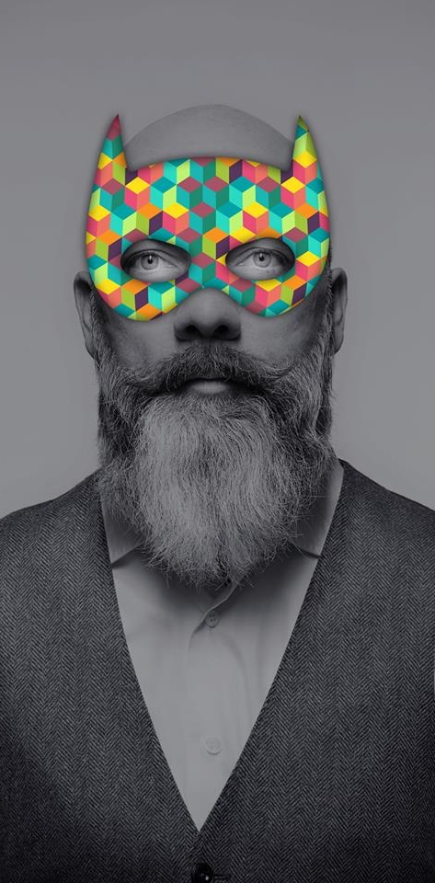
Some insights about the FNB Innovation Program in a recent interview with
Yolande Steyn: Head: Innovators Programme
Up to date disbursed over R42.5 million to innovative employees
Since 2004 FNB considered more than 10,000 ideas and implementation has been across the board, from small to much larger scale interventions
It was awarded most innovative brand in 2012, and the innovation award kept coming since then
KAPOW! Knowledge is
your Superpower!

Slide 16
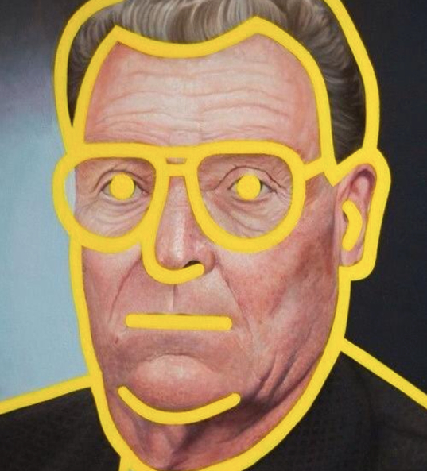
IMPROVING Future-FIT Marketing Education
KAPOW! Let knowledge be your Superpower!

Slide 17



Marketers lack the skills to successfully engage with the connected individual.
82%
75%
of marketers receive no formal education in digital marketing.
of CEOs think that specific hiring and training strategies to integrate digital technologies throughout the enterprise, are key to getting the most out of digital investments.
The digital skills gap is costing US business
$1.3tr per annum in lost productivity.

Slide 18
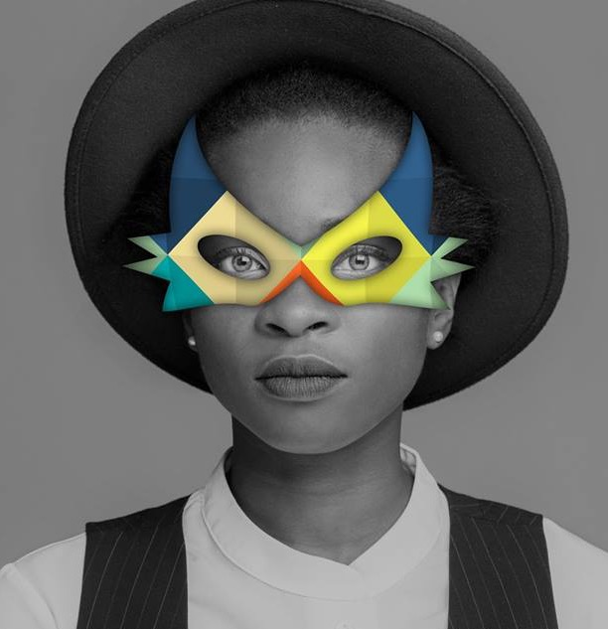
Marketers overwhelmed by scale, scope and pace of change of digital. They are struggling to cope in a world where they have less power in the relationship with individuals.
They need help to understand, select and master the technology available.
They are seeking a simple, easy to understand and communicate overarching story.
Marketers want to understand how to operate in the era of connected individuals.

Slide 19

What makes Boo-Yah! different?
Kill the Rock Star
No ego’s. No Jargon. No Geek Talk.
Goodbye “Technophobia”,
Hallo Techniques
By the end of our training courses you will be a tech warrior of Industry 4.0.
You will be FIT to survive the FUTURE.
You will have all of the Techniques, and road maps with tactical application to improve your digital transformation and be a key player in the innovation space.
Goodbye Socrates!
Attention is a finite resource and therefore Boo-Yah! will ”FUN”ducate not ”BORE”ducate with highly interactive course material – Experiential learning with Tech Play, Case Studies. We Teach the problems and empower you with solutions
Old Things in a New Way, New things in an old way
We teach you the new approach to Marketing and tap into the disruptive shift to evolve, grow and thrive.
A Marketers Dream
Course material prepared by marketers for marketers.

Slide 20
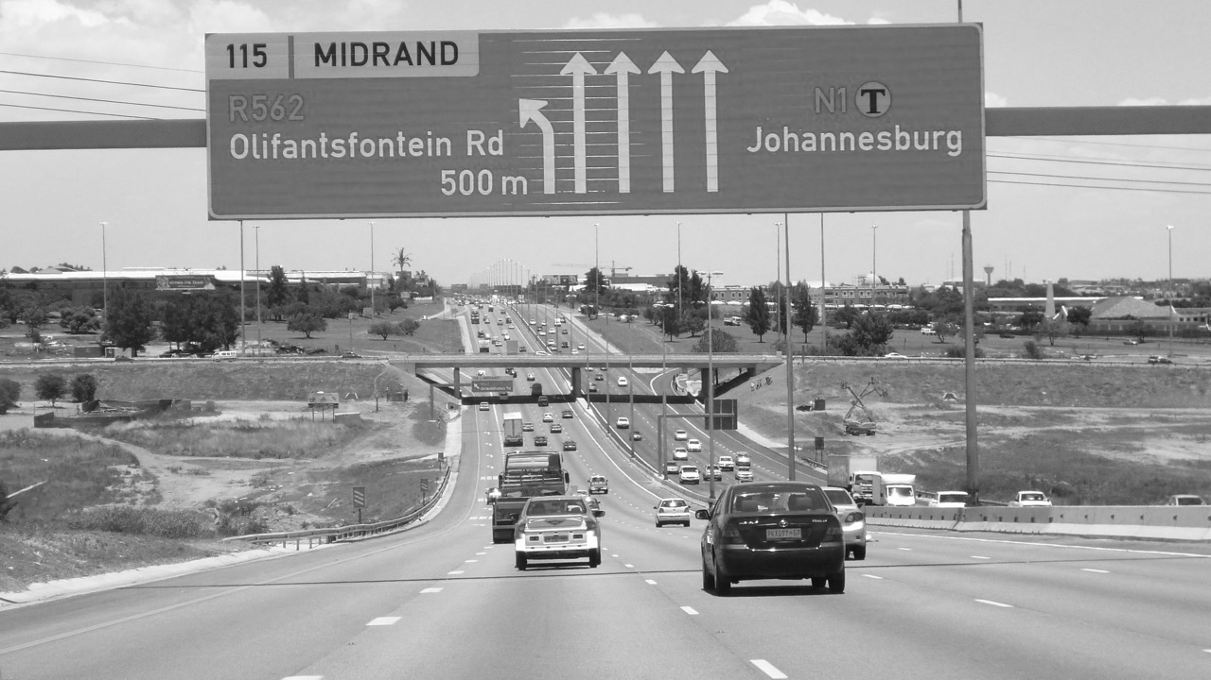
Think of the courses as the on-ramp to the freeway
Notes:
Find that Tech Enablers have a very complex way of transferring information that can be intimidating and we have unique ways how we get people on the fast track

Slide 21

Three ways to learn
PRIVATE DINNERS & WORKSHOPS
For senior teams managing the strategic direction of their company. These dinners provide inspiration and information around a specific subject and are designed to prime the internal conversation around how to best use new innovative technologies
MASTERCLASSES
& COURSES
One or two day courses designed to introduce marketers to crucial new technologies. Some of the course offer accreditation and formal qualifications. All are approved by leading educational standards bodies
BESPOKE TRAINING PROGRAMMES
Boo-Yah! can create new courses specifically designed for your company and industry. These focus on your learning objectives and take advantage of the modular structure of our training programmes – effectively allowing you to pick and choose elements of other course that are most relevant to your company.
Notes:
Some of the courses people can attend when we offer courses at a public venue and others we can do for a team of 10. Bespoke tailored to the needs, where we do a discovery session and build a unique course for the needs of the business.

Slide 22

We offer In-House & Public Training Courses

Slide 23



Courses
Strategy
The Rise of
The Connected MarketerTM
Notes:
I am going to talk to you about the TCM approach. You gonna find yourself nodding its familiar. We know this. It’s rooted in the underlying principles of Marketer.

Slide 24
Boo-Yah! has partnered with The Connected Marketer™ a connected marketing advisory and educational marketing services company from the UK.
With offices in Middle East and the UK. Boo-Yah! will be The Connected Marketer™ office for Africa.
The Connected Marketer™ has already trained thousands of marketing professionals from around the globe from hundreds of global organisations.
Some of the organisations include:
Adidas, P&G, Unilever, Coca-Cola, The Home Depot, FedEx, Kraft, Pepsi, Phizer, Red Bull and over 20 mobile operators. Agency groups which includes most big agency groups, like Ogilvy, Mediacom, Mindshare, Carat, M&C Saatchi.

Slide 25
connected devices > constantly connected.
constant connection > connectedness.
connectedness > behavioural change.
The Connected Individual
Who is attracted to connected brands
This leads to the rise of The Connected Marketer
TM
Notes:
They are the Connected Marketers. I can explain the connected marketer to you in a minute or so.

Slide 26
What is a Connected Marketer?
The Connected MarketerTM creates, develops and maintains a brand that understands and meets the needs of the connected individual.
The Connected MarketerTM merges and synchronises physical, digital, emotional sensorial brand experiences.
The Connected MarketerTM embraces the TCM Framework:
4 Key Tasks
7 Layers of Connectivity
4 Human Dimensions
Notes:
The Connected Marketer therefore creates, develops and maintains a brand that understands and meets the needs of the connected individual

Slide 27

The Connected MarketerTM Overview
We help to bridge the knowledge gap around how to successfully apply technology solutions in marketing through education and advisory services.
Our work supports brands, agencies, technology enablers and VC’s & PE firms.
Clients choose to work with us because we are neutral, informed, international & exceptionally well connected.
We have created
The Connected MarketerTM as an overarching approach and methodology
to building brand experiences in the age of the connected individual.

Slide 28
The Connected Marketer ™ Courses
Tiers of Courses
The Connected Marketing Approach
Proposition Development
Mobile Advertising
Mobile Marketing Essentials
AI in Marketing
Programmatic Marketing
Award in Mobile Marketing
Completed Mobile Marketing
**All of The Connected Marketer Courses are endorsed by the IDM UK, the best Marketing Education institution in the world with extremely distinguished standards. The Award in Mobile Marketing is the only accredited Mobile Course in the world.

Slide 29
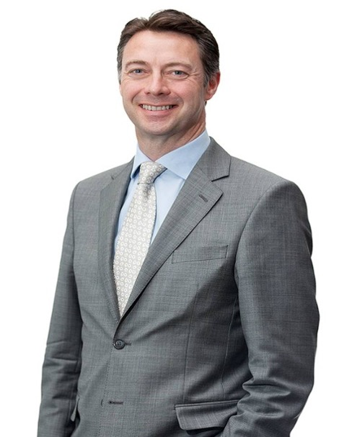


About Founder of The Connected Marketer Paul Berney
Paul is the Founder of The Connected Marketer TM and a recognised global expert in mobile marketing. Over 15 years he has advised hundreds of brands, agencies and technology vendors on the role of mobile and connected devices in marketing. Paul has been a keynote speaker and Chair at over 350 events, in 42 countries. For 30 000 people.
Previously, Paul served as Chief Marketing Officer & EMEA Managing Director of the Mobile Marketing Association (MMA). He has over 28 years’ experience in a wide variety of sales, marketing, business development and commercial roles spanning industries and market sectors including automotive, printing, digital and management consultancy.
He is a Business Leader in The Marketing Society, a Fellow of the Institute of Direct & Digital Marketing (IDM), a Member of the Chartered Institute of Marketing and a mentor in The Marketing Academy.

Slide 30
Education
The Best of Global Digital Marketing
Notes:
I am going to talk to you about the TCM approach. You gonna find yourself nodding its familiar. We know this. It’s rooted in the underlying principles of Marketer.

Slide 31
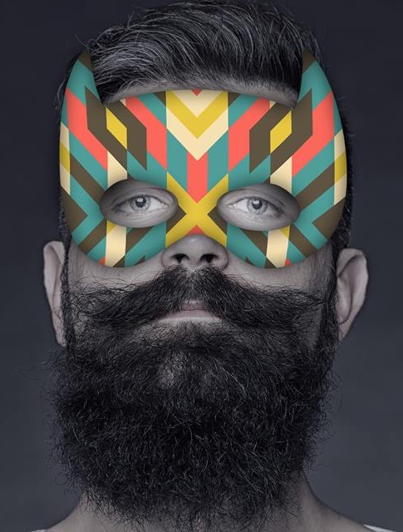
Boo-Yah! has secured an exclusive partnership and will be the Africa representative for
The Best of Global Digital Marketing
Best Marketing International is one of the leading and most successful producers of workshops and in-house trainings on digital marketing in Europe. The multinational team, consisting of world-known marketing gurus, visits every year 10-15 different countries sharing their insights and experiences on digital marketing campaigns. Seth Godin, Martin Lindstrom, Mark Tungate and Mike Berry are just few names we work with.
Established in 2003, Best Marketing International has grown to a well-known name in digital marketing conference and training field. We have organized over 100 marketing conferences in more than 30 countries all over the world.

Slide 32
Digital marketing case studies with excellent business results and in-depth analysis of why these campaigns were successful.
The case studies are assembled experienced reporters and researchers who collects the information. All case studies are covered in depth, with examples of creative work, interviews with clients and/or their agencies.
The main lessons from each award-winning case study are summarized. The company will get their daily dose of inspiration and new ideas to take their digital marketing to the next level.

Slide 33
Bespoke Masterclasses of
global case studies
Every masterclass is created around the needs of the client. When we build these masterclasses we do a diagnosis to have an in-depth understanding of all the challenges marketers and agencies deal with in their environment.
We then build a unique masterclass of 20 recent case studies with the following:
Case Film
All background information
Frame work
Analysis
Reporting
These masterclasses are inspirational and colorful and we guarantee that the business will walk away with at least one Idea they can immediately implement.

Slide 34
About Founder Hando Sinisalu
Hando Sinisalu is a marketing journalist, researcher, conference speaker and producer. He is the founder and CEO of Best Marketing International, the leading marketing conferences producer in Europe. Hando has produced and managed over 300 conferences in over 30 countries from Tel Aviv to South Korea, from Indonesia to Spain.
He has experience in both content creation and event/business management.
Hando collects and analyses digital marketing case studies. He is the producer of the Best of Global Digital Marketing Show and writes regularly for the marketing portals in Estonia, Malaysia, Turkey, Poland and Indonesia. He is also an official representative of Cannes Lions Festival in Estonia and has helped American Marketing Association to establish Effie Awards programs in Croatia, China and Ukraine. Hando has an MA degree in Communications from Ohio University(USA).

Slide 35
Education
Boo-Yah! Innovation Masterclasses
Notes:
I am going to talk to you about the TCM approach. You gonna find yourself nodding its familiar. We know this. It’s rooted in the underlying principles of Marketer.

Slide 36
Boo-Yah! Masterclasses
Don’t Copy! But DO Simulate, Innovate, Elevate
Storytelling through packaging: Marrying physical and digital to create content
Fundamentals to Delight and Disrupt by activating brand purpose
How to build a culture of Idea Hunters
Future-Fit for tomorrows realities
The 5 layers of innovation inspired by the Cannes Lions Festival
Power of 3 to build an impactful campaign: Data Science, Creativy, Technology

Slide 37
DAY-TO-DAY Consulting
Let Boo-Yah! put the KAPOW!
Back into your Strategy

Slide 38
Consulting
Expertise
Brand Purpose
Mobile & Tech
Futurist
Innovation and Problem Solving
Marketing
Digital
Data Science
We help companies:
Help you set up Innovation Hubs
Strategy (Tech|Innovation|Data Science | Brand Purpose)
Strategic Facilitation
Pitches & Ideation
Find the right partners
Marketing Campaigns
Innovative Research Projects
The Connected Marketer Strategy in collaboration with Paul Berney

Slide 39

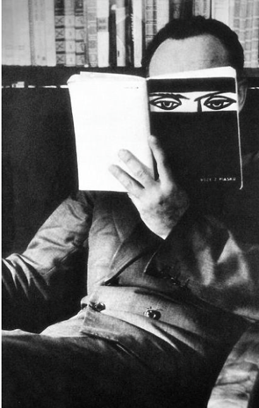

The Boo-Yah! Approach
Our Innovation Consulting Model - we fill the gap where required
Initiate
Inspire
Improve
Imagine
Invent
Implement
Insight
Influence
I’s

Slide 40

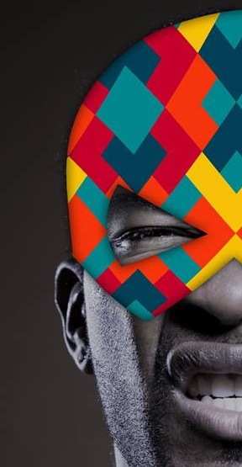

Why Use us?
Boo-Yah! is a proud member of the Internet Advisory Board(IAB)
We serve on the Education and Transformation Committee of the IAB
We are the exclusive representative of The Connected Marketer™ courses in Africa , endorsed by The Institute of Direct and Digital Marketing (IDM) from the UK
We have partnered with Best of Global Digital Marketing and representing global case studies, industry specific for in-house training purposes
Founder, Carmen Murray, host of the WITEE Chatterbots Radio Show and she is a highly acclaimed keynote speaker who delivered over 100 events in 20 countries

Slide 41
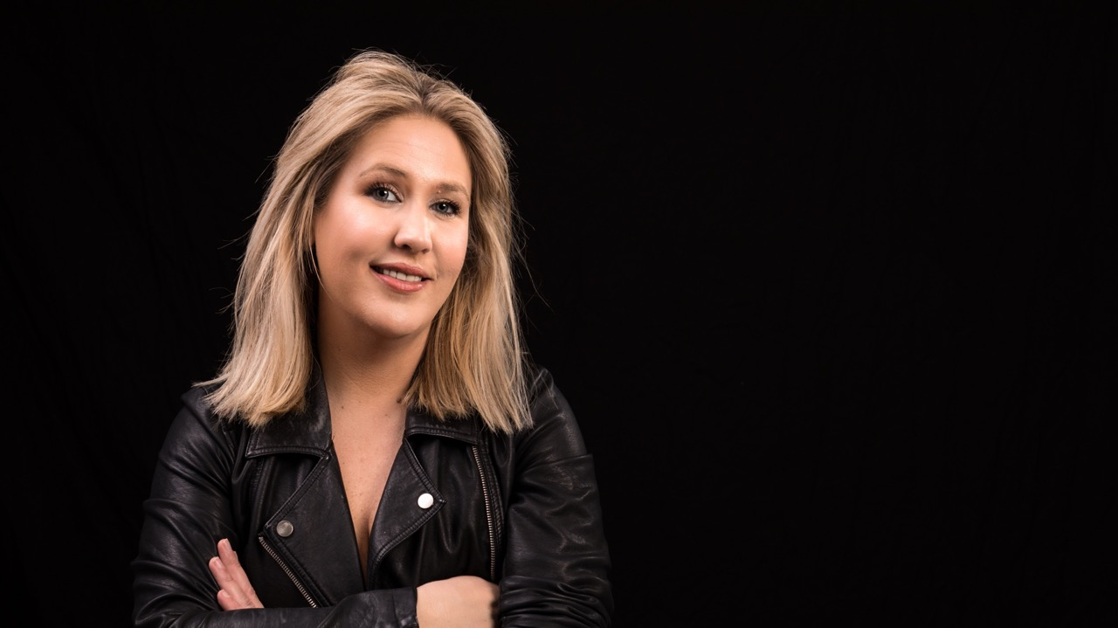

Founder of Boo-Yah! Carmen Murray
Carmen has become a household name among marketing professionals as a result of her inspirational ”masterclasses” These sessions have reached thousands of marketers across SA. Masterclasses inspire marketers to disrupt and delight addressing sessions such as Mobile Innovation, Gamification, the 4th Technology Transformation, Fueling Creativity and Applying Inspiration, Brand Purpose and where great ideas come from.
2017
BOO-YAH! EDUCATIONAL MARKETING SERVICES COMPANY
She is a Business Strategist in: Tech | Innovation| Data Science| Brand Purpose
Carmen’s big personality and presentation style can also be found on the airwaves on The WITEE Chatterbots Show
(Women in Tech Empowering Everyone)
Carmen has been a inspirational speaker at more than 100 events in 20 countries to a combined audience of over 21,000 people
Industry Contributions include MMA, IAB, DMA, MRMW, AMASA, BOGDM, Brand Live, Social TV, RebaOne Academy, GIBS, AAA School of Advertising and an array of international business schools.
Carmen is also the local trainer and collaborator of content for The Connected Marketer Training Courses from UK, and the Best of Global Digital Marketing training from Europe
Carmen Is certified with the IDM and DMI

Slide 42
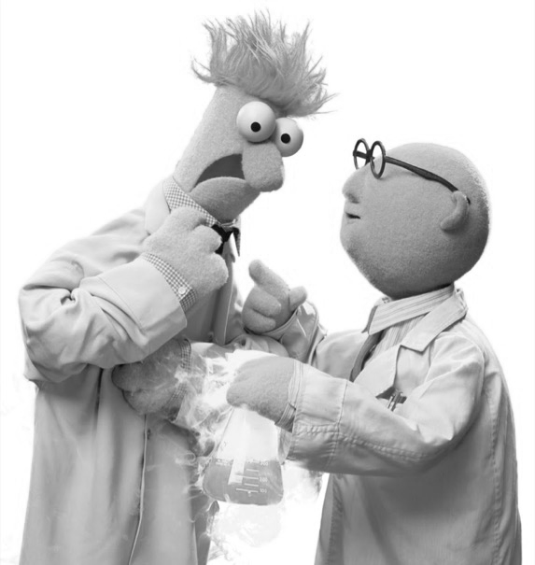
Hire people that know this stuff.
Or learn new skills.
Notes:
if you want to understand how to become a connected marketer you either need to hire someone who knows how to do this stuff, or learn new skills. Hundreds- brands- skills to this. New skills approaches

Slide 43

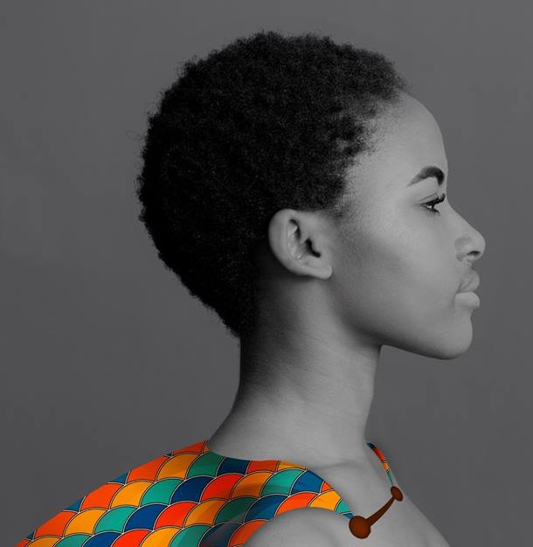
Let knowledge
be your superpower

Slide 44


THANKYOU

